Slide 1
System Shopper
Andrew Kingston, Max Dunham, Samuel McRaven

Slide 2
Use Cases
Create account and sign in
Add single item to cart
Use System Builder to add items to list

Slide 3
Create Account and Sign In
Start in Home Page
Go to account signup
Enter information
Create account, go to login window
Login with information
Go to account settings

Slide 4
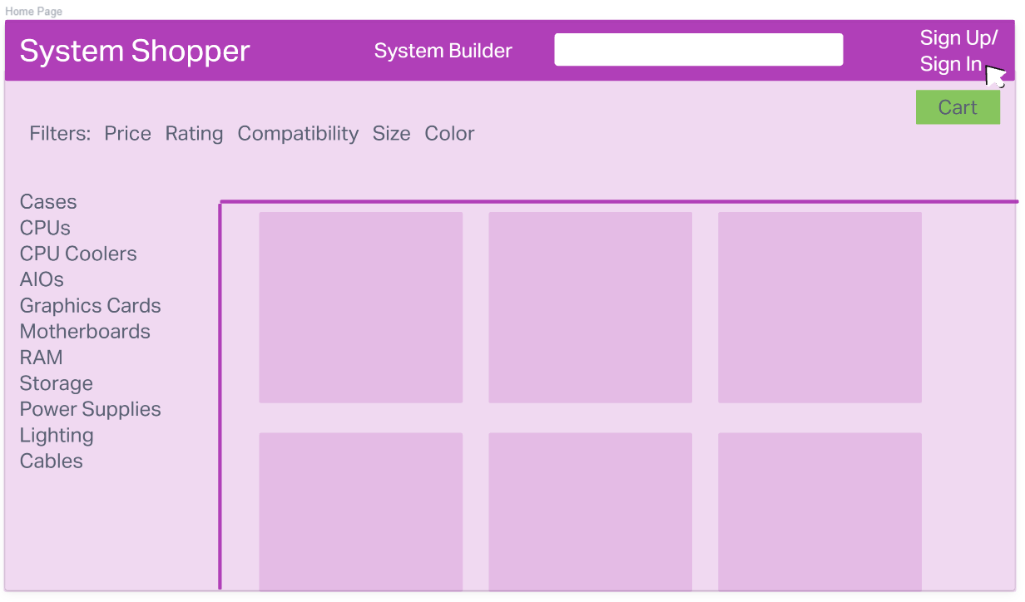

Slide 5
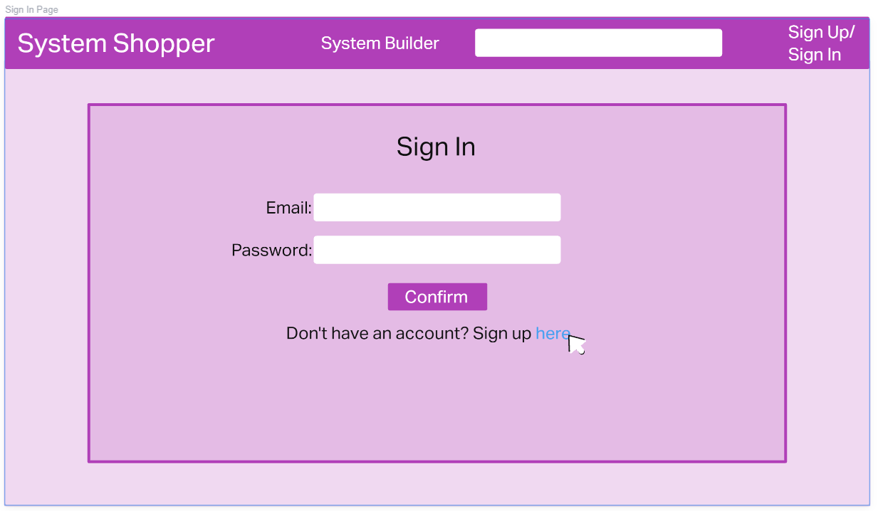

Slide 6
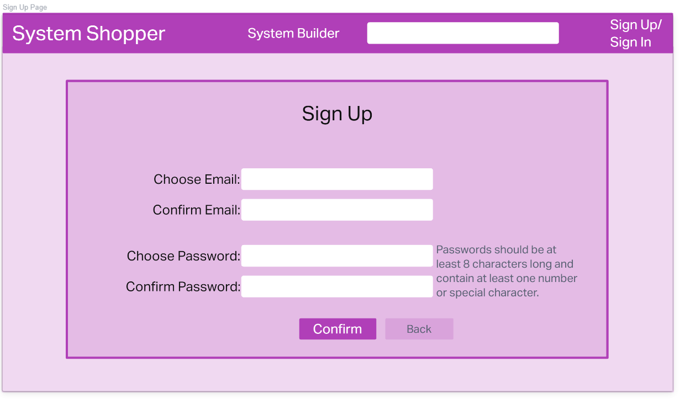

Slide 7
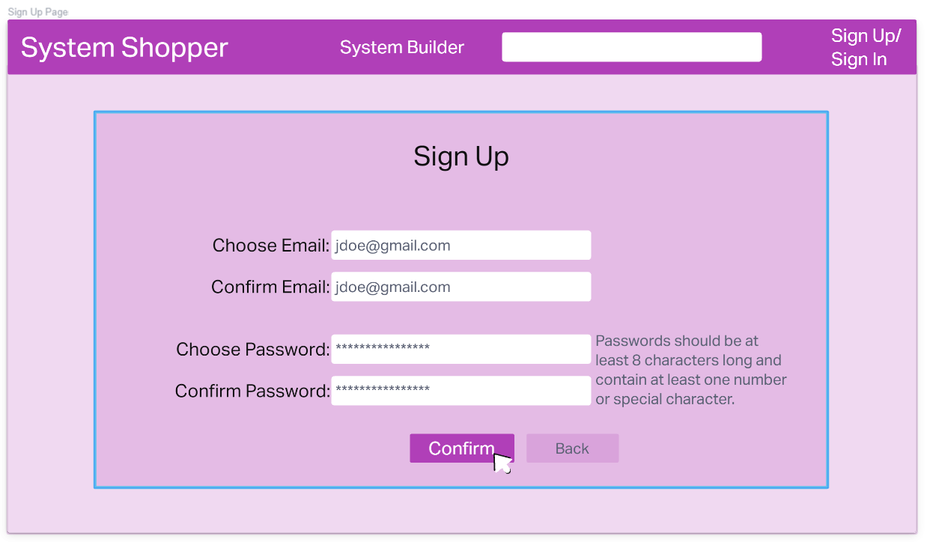

Slide 8
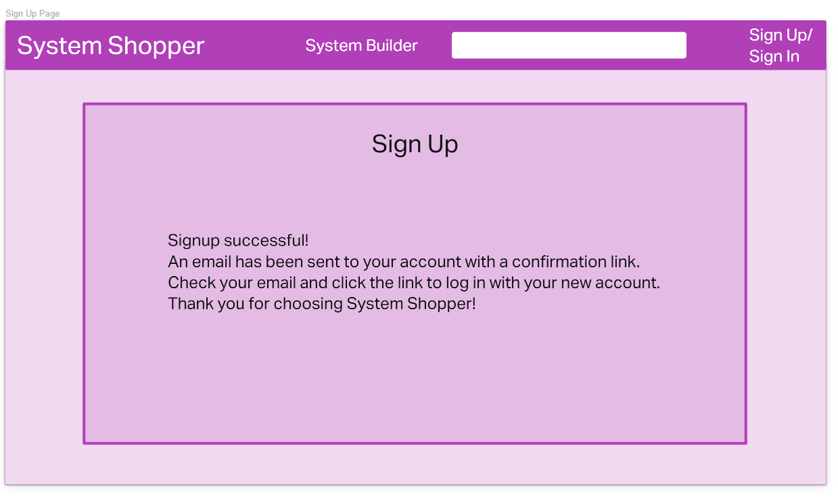

Slide 9
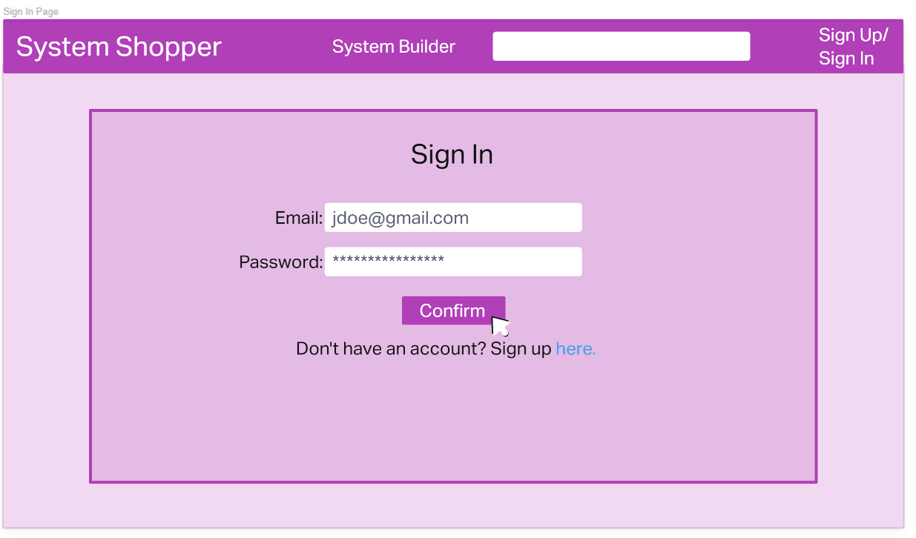

Slide 10
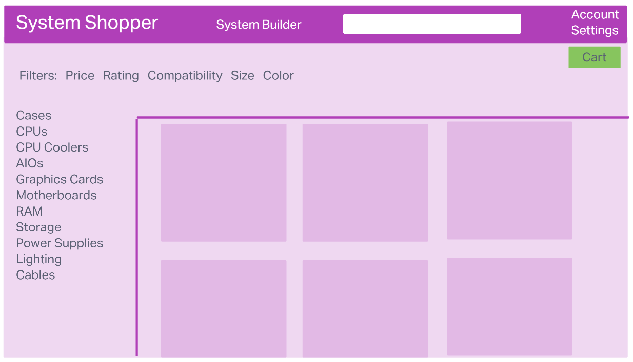

Slide 11
Add Single Item to Cart
Start in Home Page
Search/Filter for item
Click item, go to item page
Click Add to Cart
Go to Cart with item
Display information

Slide 12
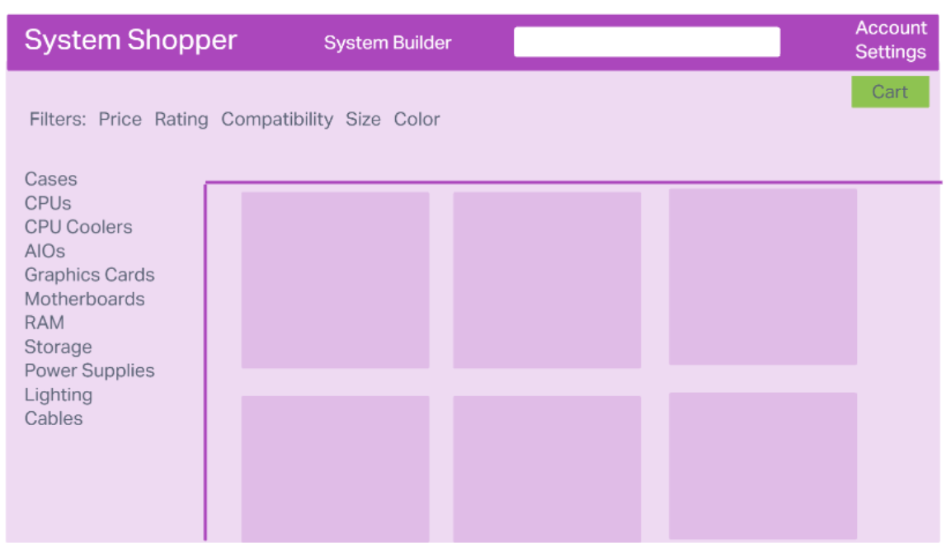

Slide 13
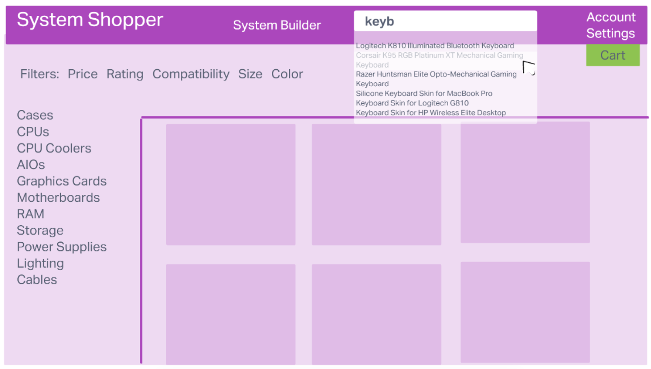

Slide 14
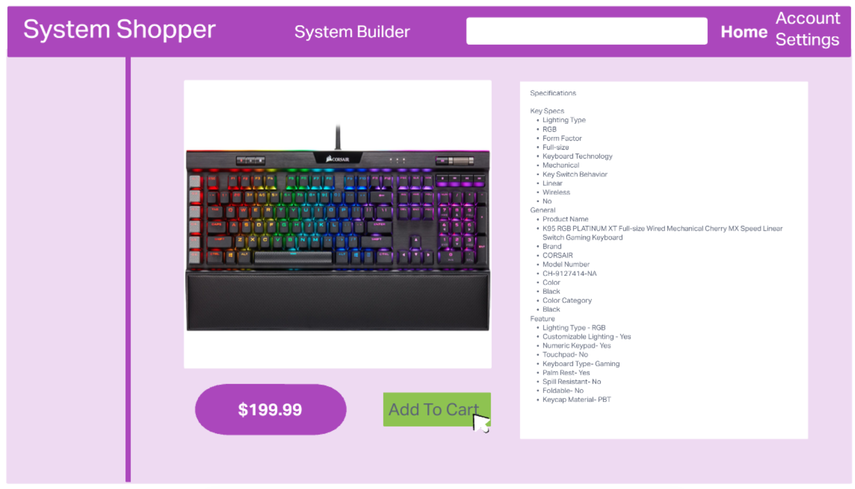

Slide 15
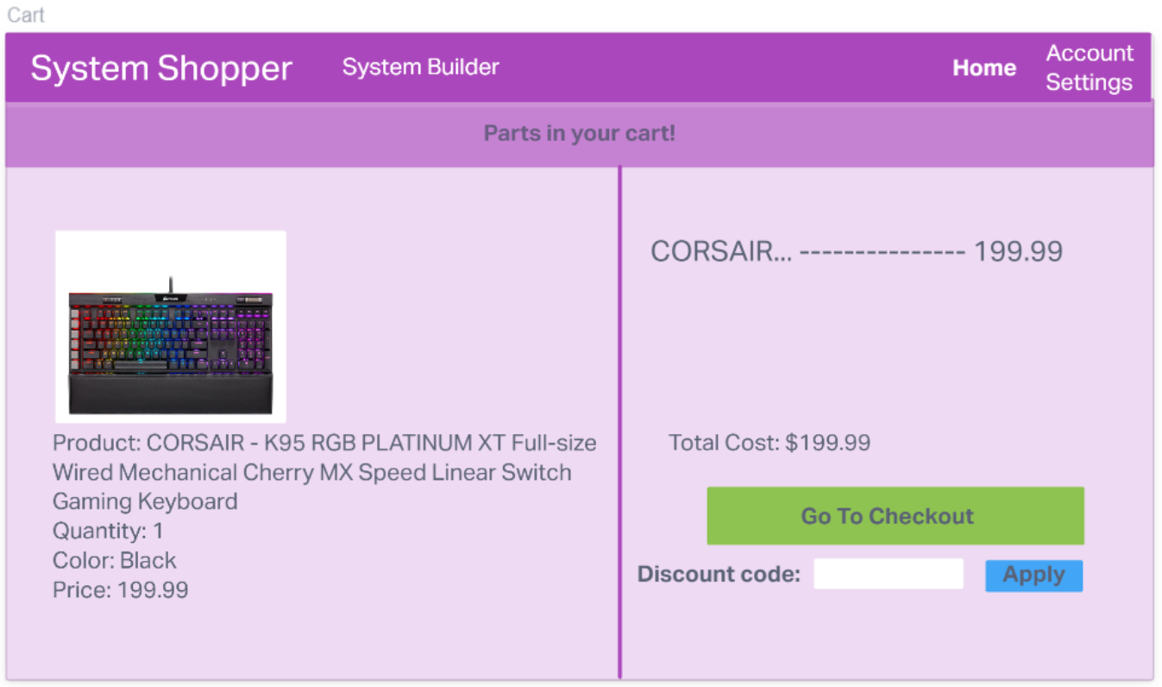

Slide 16
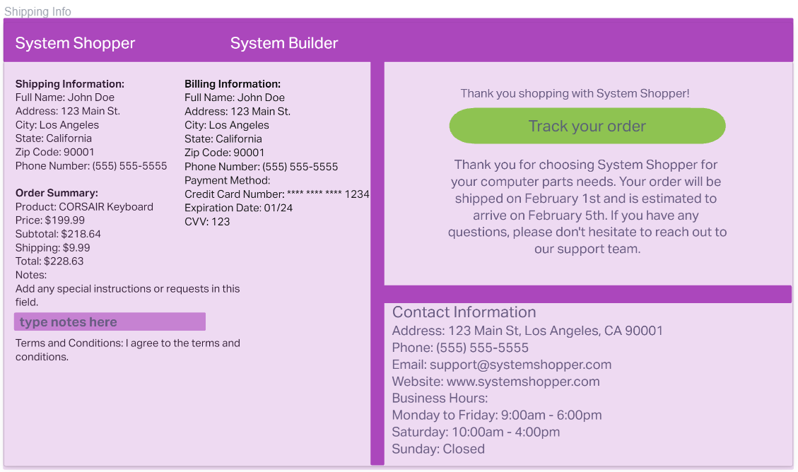

Slide 17
Use System Builder to Build List
Start in Home Page
Go to System Builder
Select 3 items to add to list
Display items on sidebar
Go to cart with items

Slide 18
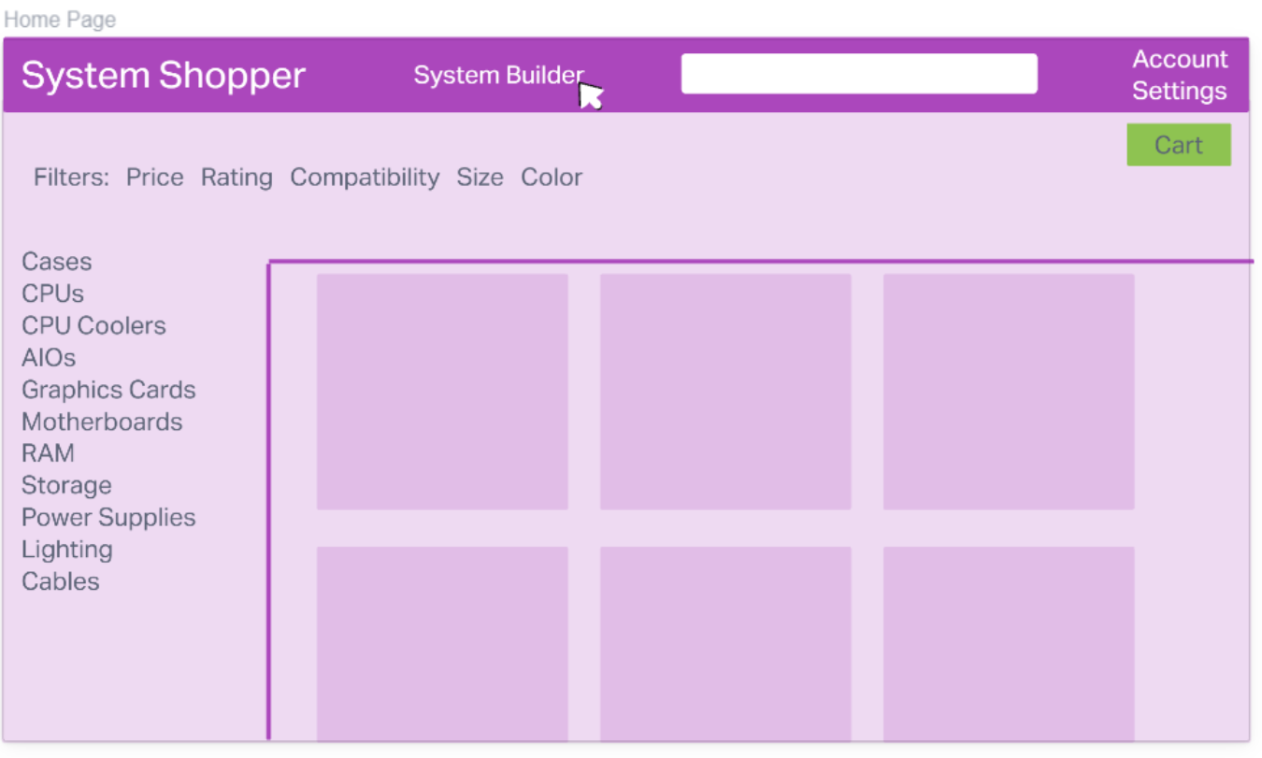

Slide 19
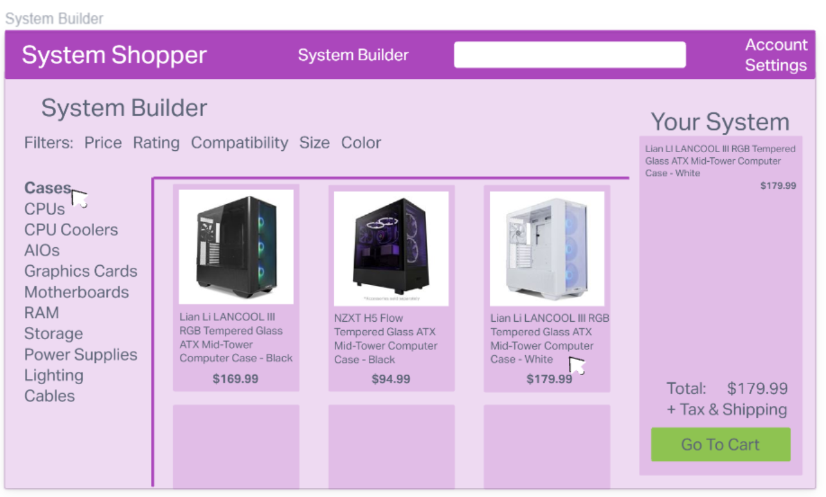

Slide 20
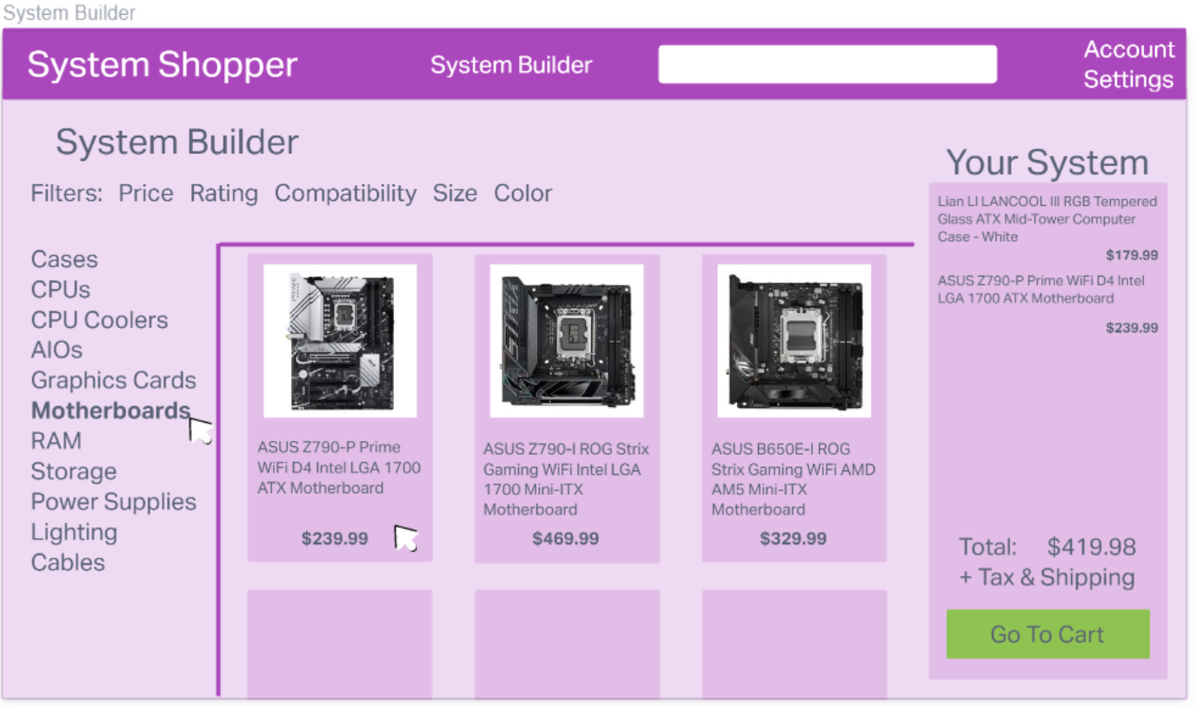

Slide 21
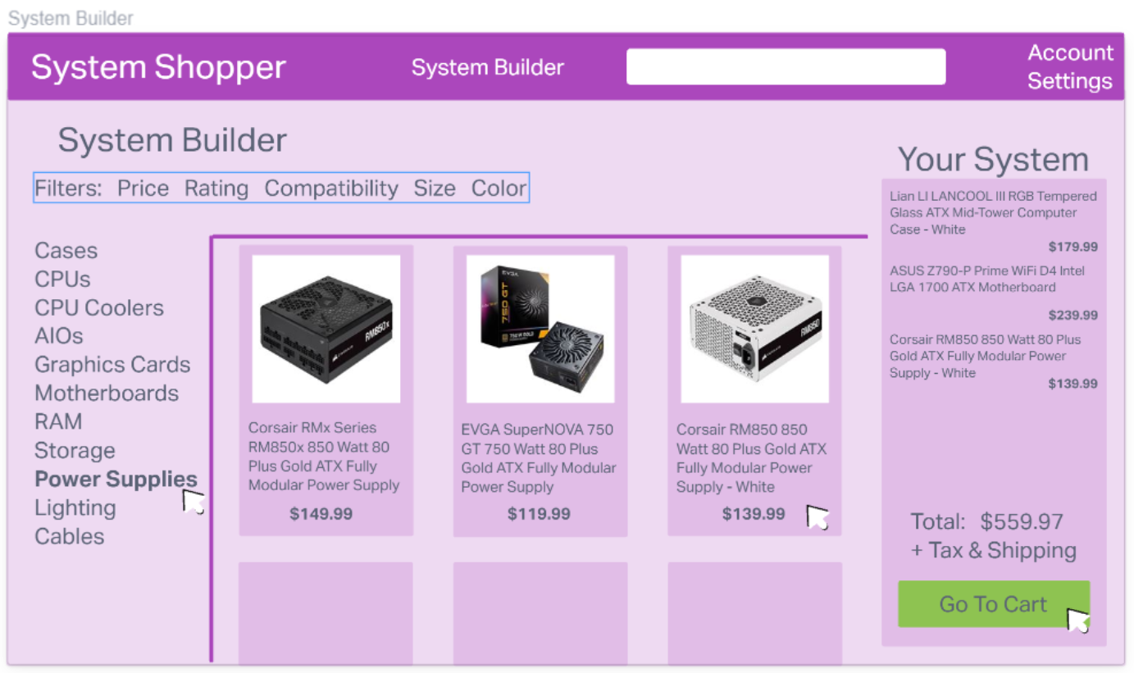

Slide 22
